Slide 1
Why Business Value Should Be Your First Concern and How to Create More of It
Brought to you by

Slide 2
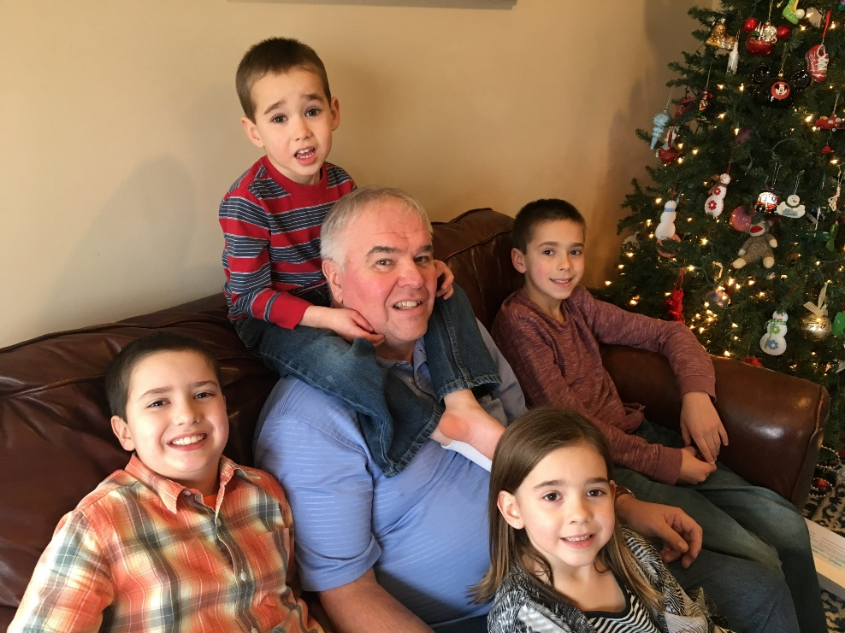
Meet Your Presenter
Arlin Sorensen
VP of Brand and Ecosystem Evangelism
ConnectWise
Husband, Dad and “Pop”
Farm Boy from Harlan, Iowa
42 years in agriculture
36 years in the technology space
Confidential and Proprietary. All Rights Reserved

Slide 3
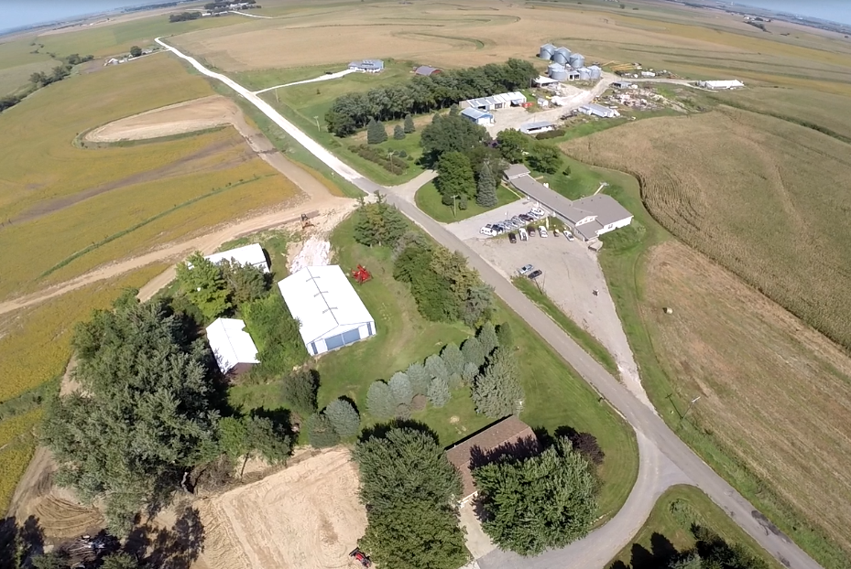
Pete
Dean
Dean
Where I Come From
Pete
Arlin
3000 acres corn/soybeans in Shelby County, Iowa
Brad
Arlin
Brad
2500 acres corn/soybeans in Shelby County Iowa
Confidential and Proprietary. All Rights Reserved

Slide 4
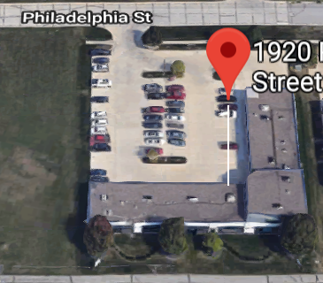
Heartland Companies Legacy
Legacy Phase 1 - 2012
Legacy Phase 2 - 2018
Legacy Phase 3 - 2018
Heartwood LLC
2012
14 years
27 years
Sold June 2018
Sold end of 2012
18 years
Sold January 2018
Employee today – office in Florida, on the road, and on the farm
1985
2000
2004
Confidential and Proprietary. All Rights Reserved

Slide 5
Heartland Companies Current
Sorensen Brothers Farms LLC
Since 1977
Since 1995
Since 2015
Family Farming Operation
Precision Agriculture Business
Business Consulting
MANAGING LEGACY IS THE PRIMARY ROLE OF THE LEADER
Confidential and Proprietary. All Rights Reserved

Slide 6
What is Business Value?
ECONOMIC VALUE - $$$$$
Confidential and Proprietary. All Rights Reserved

Slide 7
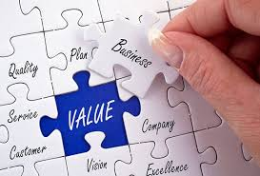
What is Business Value?
BUT ALSO …
Customer value
Vendor relationship value
Partnership(s) value
Colleague value
Leadership and Management value
Social value
Brand value
Confidential and Proprietary. All Rights Reserved

Slide 8
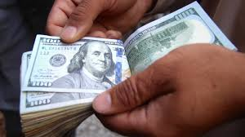
Business Value Translation…..
What is someone else willing to exchange for the business value you have created?
Normally measured in $$$$$
Priority #1
NO ONE else on the team that is not an owner ever worries about building value
Confidential and Proprietary. All Rights Reserved

Slide 9
Why Business Value Matters….
Each of us should have a PWT (Personal Wealth Target)
If we own a business, often the BVT (Business Value Target) is a key component of achieving our PWT
Personal Net Worth + Business Value (minus taxes and divided among shareholders) = Personal Wealth
Will your personal wealth sustain the lifestyle you desire after you are done earning a paycheck?
Confidential and Proprietary. All Rights Reserved

Slide 10
Is it enough?
Confidential and Proprietary. All Rights Reserved

Slide 11
Four Percent Rule
The 4% rule is a rule of thumb used to determine how much a retiree could withdraw from a retirement account each year and not run out of money.
Provides a steady income stream while maintaining an account balance that keeps income flowing through retirement.
Experts consider the 4% withdrawal rate to be safe.
There are situations where this rule does not apply.
*Safe Withdrawal Rate study from Trinity College (93% effective)
Confidential and Proprietary. All Rights Reserved

Slide 12
Know Your Number….
Current guidance from financial planners
25X to 40X what you spend annually to live today
$100K annual spend means personal wealth target of $2.5M to $4M when money stops flowing in
That assumes a burn rate of 2.5% to 4% of the principal (worst case)
This has to be after tax, and available
Your personal wealth target is a math calculation
Confidential and Proprietary. All Rights Reserved

Slide 13
Know Your Non-Negotiables….
Deal Structure
Cash up front/payments over time/seller note/earn out/other creative tools
Timeline
Act 2 – what’s next
Team
Culture
Core values
Markets
Customers
Confidential and Proprietary. All Rights Reserved

Slide 14
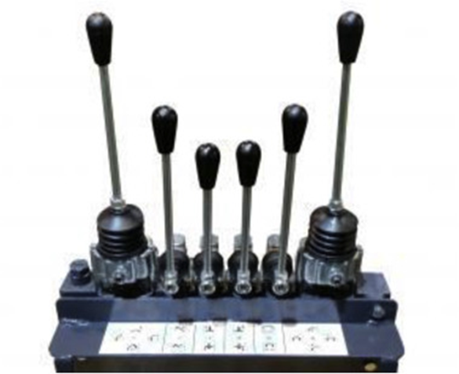
Manage the Levers!
Know what you can do to drive up your business valuation and make the main things the main things.
Confidential and Proprietary. All Rights Reserved

Slide 15
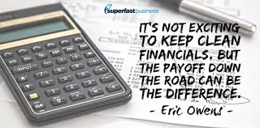
Business Value Levers
Financial performance
Not just top line revenue (growth)
Not just EBITDA (profit)
Biggest Driver: Recurring Revenue
Businesses are paid for with available cash flow
Clean numbers are a big plus – addbacks vs deducts
Valuation calculators can help
Multiple of EBITDA
Revenue stream values
Confidential and Proprietary. All Rights Reserved

Slide 16
REALITY:
Your business is worth what someone will pay for it.
Confidential and Proprietary. All Rights Reserved

Slide 17
Business Value Levers
Preparation
There will be a transition
Prepare now
Due diligence should guide preparation
Organize, scan and store information the way buyers will want it
Gives confidence
Confidential and Proprietary. All Rights Reserved

Slide 18
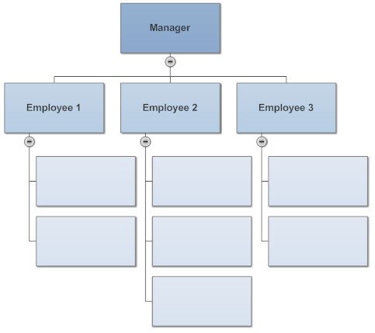
Business Value Levers
People
Make yourself replaceable
Strong leadership and management
Consistent people investment and growth
Well defined org chart with accountability
Strong HR practices
Confidential and Proprietary. All Rights Reserved

Slide 19
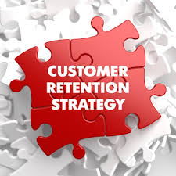
Business Value Levers
Customer and Revenue Retention
Long term customers
Assignable contracts
Revenue growth from:
Current customers
New customer acquisitions
Low customer revenue concentration
Retention growth from base
Confidential and Proprietary. All Rights Reserved

Slide 20
Business Value Levers
Have an integration plan
Skillsets identified
Processes documented
Policies defined
Helping the acquirer get to positive ground sooner than later is a huge driver
70–90% of M&A transactions fail to meet expectations
Confidential and Proprietary. All Rights Reserved

Slide 21
M&A Integration Curve
Motivation/morale
Performing
Executing
Overwhelmed
Accepting
Frustrated
Excited
Resisting
Understanding
Giving In
Time
Confidential and Proprietary. All Rights Reserved

Slide 22
Business Value Levers
Know what you want post transaction
Continue as operator
Continue as consultant
Exit in 3/6/12 months
Exit on transaction
Have a post event plan
You can’t just do nothing
Golf every day gets boring
Confidential and Proprietary. All Rights Reserved

Slide 23
Your Success Roadmap
Know your number (PWT and BVT)
Know your non-negotiables
Have a plan to create business value
Operate profitably and consistently
Run with clean financials
Prepare for due diligence
Build your people
Focus on customer retention
Prepare for integration
Know what your next chapter will be
Exit and enjoy life!
Confidential and Proprietary. All Rights Reserved

Slide 24
Want a Free Calculator Tool?
Send an email to:
Arlin@ArlinSorensen.com and request….
Deck
PWT-BVT calculator
Added to daily update
Or just put ‘ALL’ in the subject

Slide 25
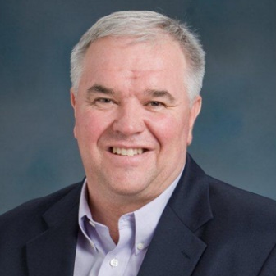
THANK YOU!
Arlin Sorensen
VP Brand and Ecosystem Evangelism
ConnectWise
653 Oak Road Harlan, Iowa 51537
(O) 712-794-7957 (M) 712-579-1216
asorensen@connectwise.com
Blog
http://asorensen.wordpress.com/
Thoughts from the Farm
Email to be Added to the Morning List
(email “ADD” to arlin@arlinsorensen.com)
Connect with me on social media!
Confidential and Proprietary. All Rights Reserved

Slide 26
Questions?
Confidential and Proprietary. All Rights Reserved

Slide 27
Thank You for Attending
Brought to you by

